Slide 1



SOFTWARE STUDIO
FINAL PROJECT PROPOSAL
SURVIVAL SHOOTER
Gerraldo 108006218
Gilbert 108006235
Stella 108006213
Terrence 108006228
Vicky 108006220

Slide 2


TABLE OF CONTENT
Motivation
User Story
Controls
High Risk Analysis
High Value Analysis
Similar Games
Concept Art

Slide 3
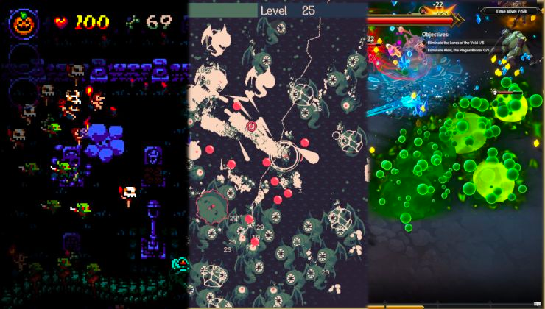
MOTIVATION (動機)
We want to make a challenging survival game, creating a high-quality game similar to Bullet Hell.
Notes:
By creating a compelling and challenging Bullet Hell game, you can attract players who share your passion for the genre and create a community around your game. By creating a high-quality Bullet Hell game, because one of us really love this game, but he think that this game should have a better quality of particle effects, and animation, so we are planning to give a better visualization of this game.

Slide 4
USER STORY (使用者故事)
Through spacecraft game,the player can
use other aircraft with different weaponsunlocked as they progress through the game
earns score from doing actions such as defeat enemy and collecting power-ups
Notes:
As a player, you find yourself in the middle of a fast-paced, intense and challenging world of a bullet hell game. You are tasked with piloting a spacecraft, navigating through a never-ending barrage of enemy fire, and defeating relentless waves of foes.
At the start of your journey, you are given a choice of spacecrafts to pilot, each with unique weapons and abilities. As you progress, you will unlock even more powerful ships and upgrade your weapons, giving you the tools you need to survive against increasingly difficult odds.
The action takes place on a 2D plane, with your ship constantly moving forward, dodging and weaving around the relentless hail of enemy bullets. The screen is filled with vibrant, eye-catching graphics and the pulse-pounding sound effects will have you on the edge of your seat.
With each level, the challenge intensifies, as you face faster and more deadly foes. But with each victory, you gain experience, unlocking new abilities and upgrading your weapons. And as you progress, you'll encounter powerful bosses, each with their own unique attacks and strategies to defeat.
As the player, you will experience the thrill of dodging bullets, the rush of victory, and the satisfaction of unlocking new abilities and upgrading your weapons. The game is designed to be both challenging and accessible, allowing players of all skill levels to enjoy the bullet hell experience.

Slide 5
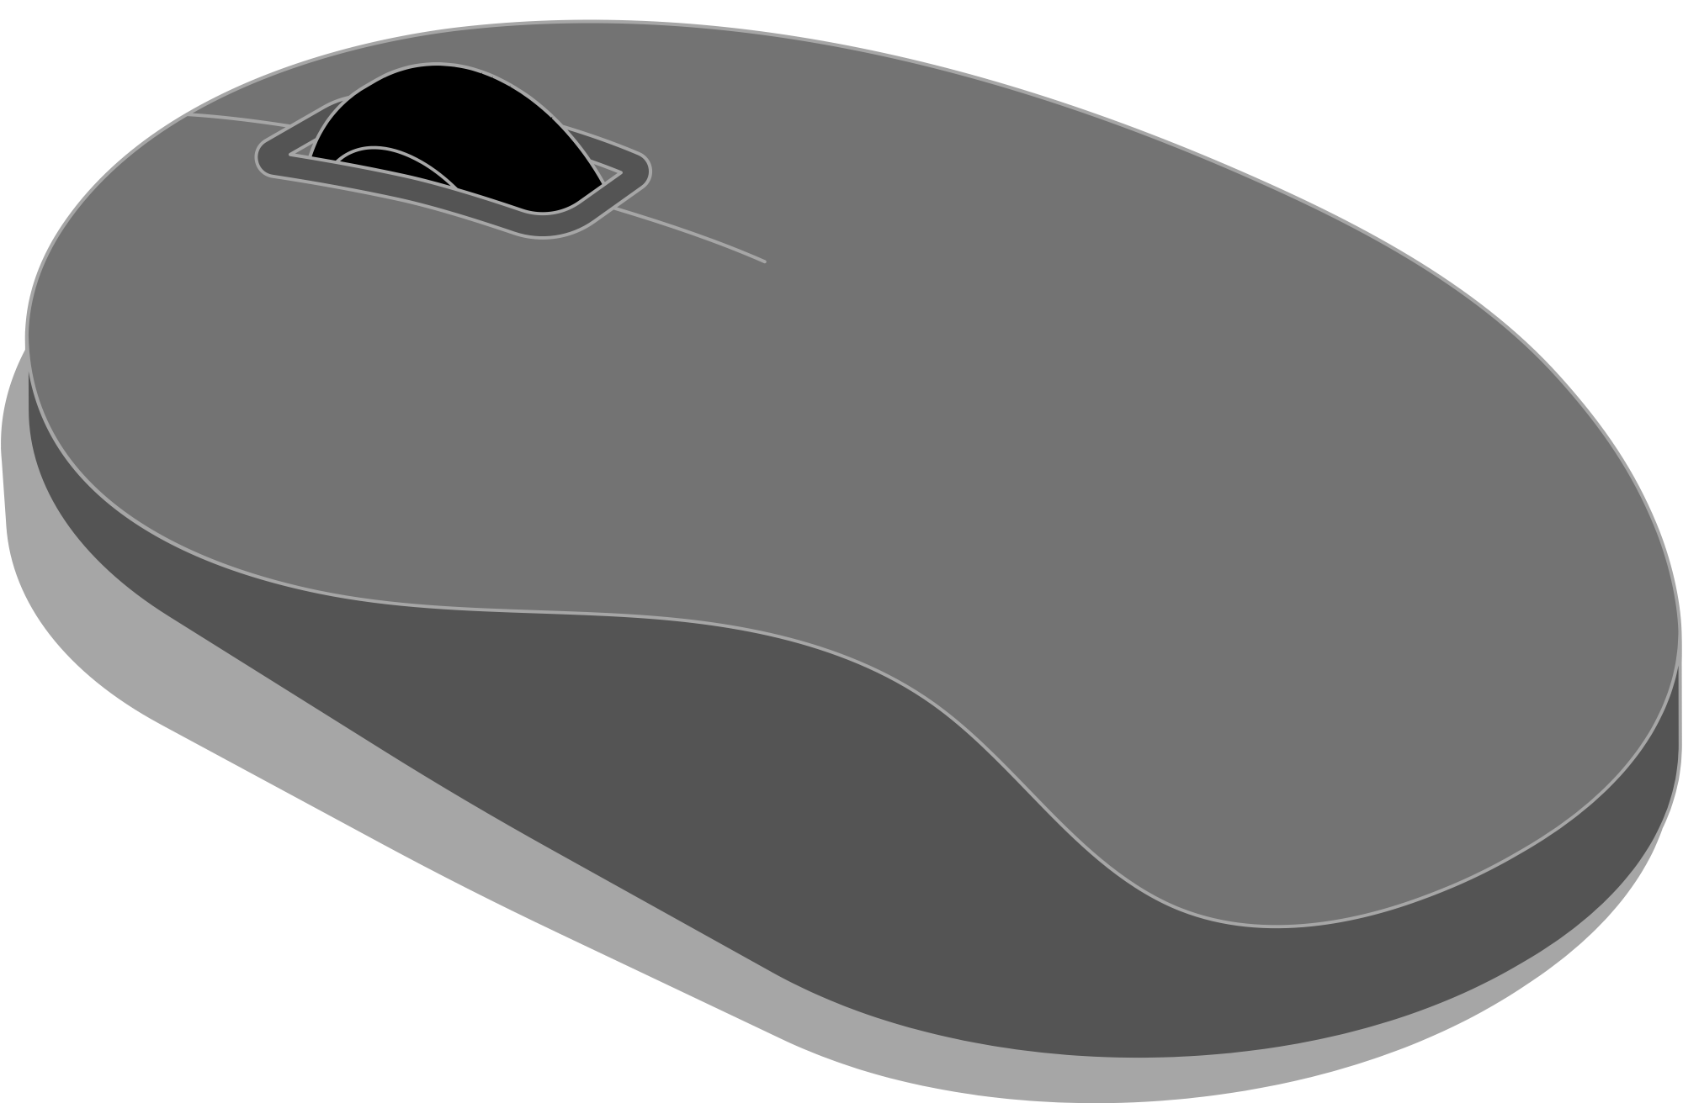
CONTROLS (操作方式)
Mouse(Menu, Power Up)
Keyboards (WASD, esc)

Slide 6
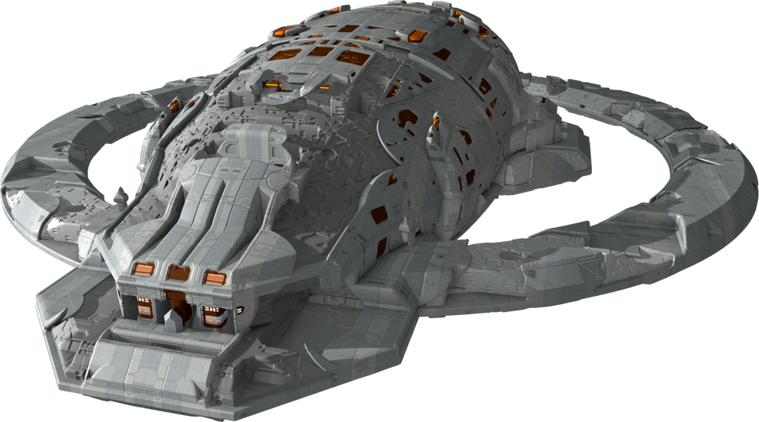
HIGH RISK ANALYSIS
(高風險分析)
Player HP and Mana
Player Movement and Controls
Bullet/ Shooting Patterns
Enemy behaviors

Slide 7


HIGH VALUE ANALYSIS(高價值分析)
Aircraft Models and Status
Unique Enemies (Bosses)
Power Up Effect
Dynamic Soundtrack

Slide 8
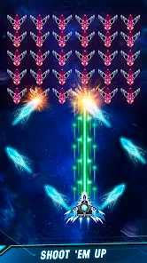
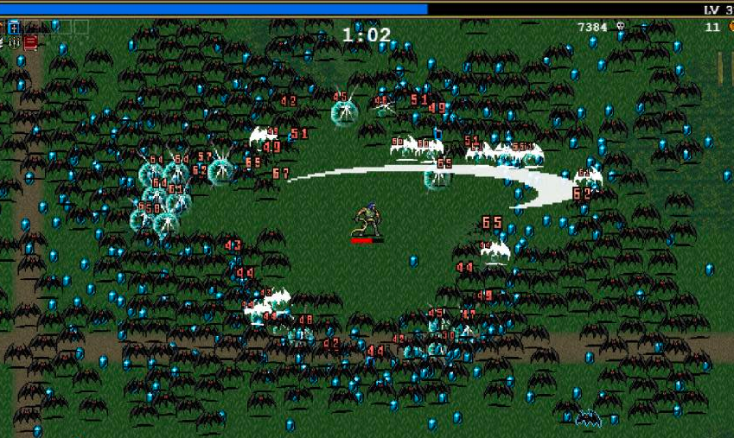
SIMILAR GAMES
(市面上類似概念的遊戲)
Space Shooter
Vampire Survivors

Slide 9
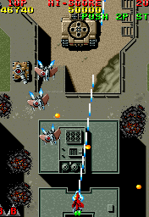
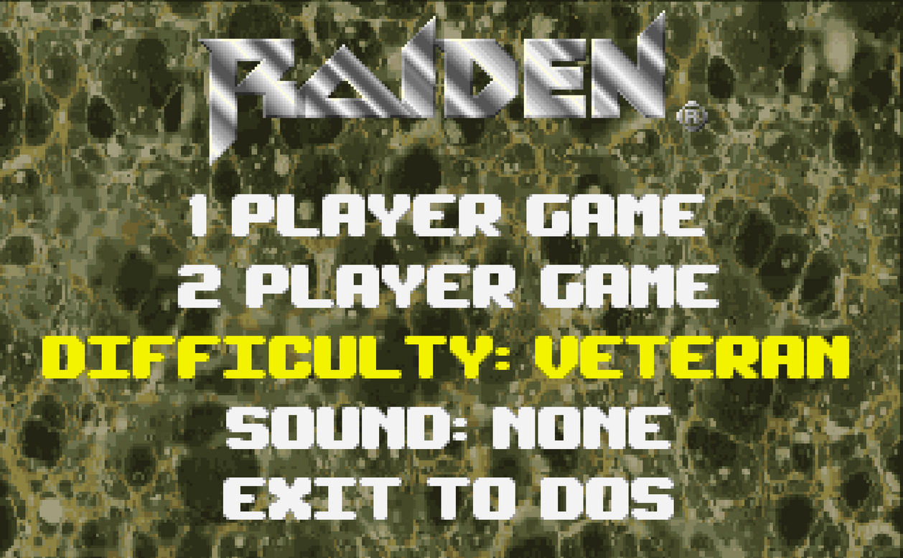

CONCEPT ART (模擬/假想畫面)

Slide 10

THANK YOU

